Slide 1
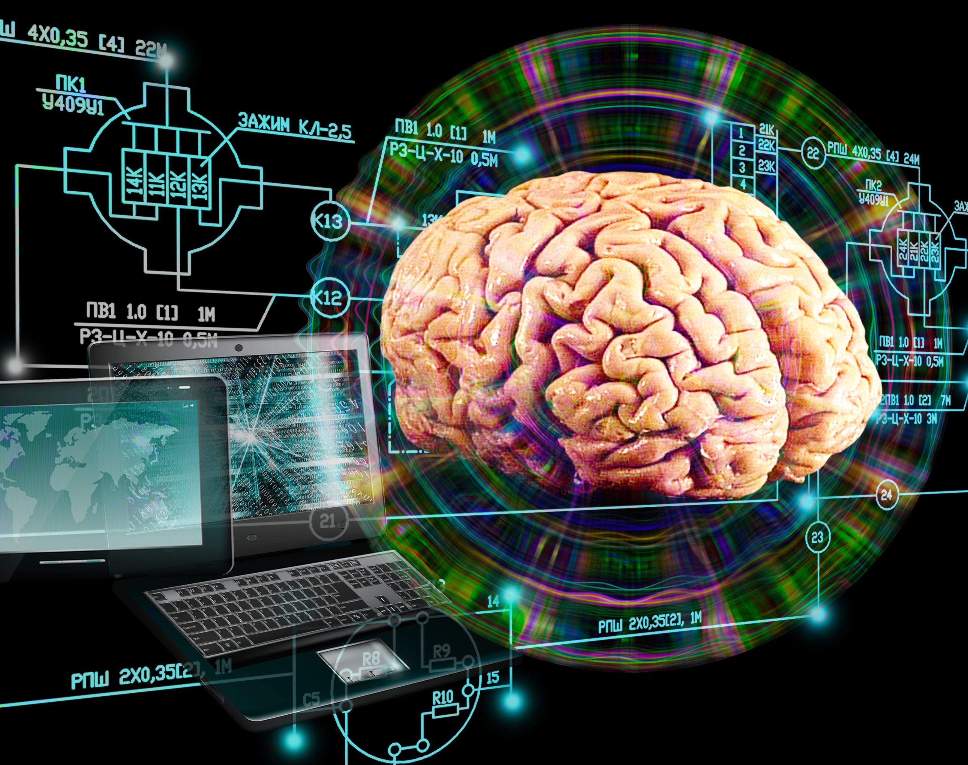
Multimodal Human Computer Interaction (MMHCI)

Slide 2
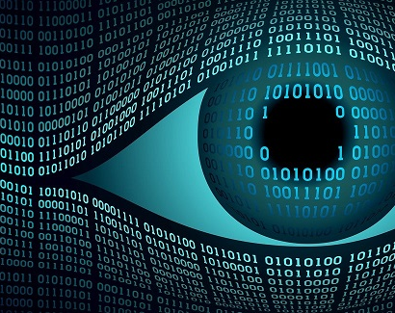
Project Focus:
Multimodal Human Computer Interaction from a Computer Vision perspective (body, gesture, gaze, and affective interaction)

Slide 3

Core Vision Techniques:
Large-Scale Body Movements
Gesture Recognition
Facial Expression and Gaze Detection

Slide 4
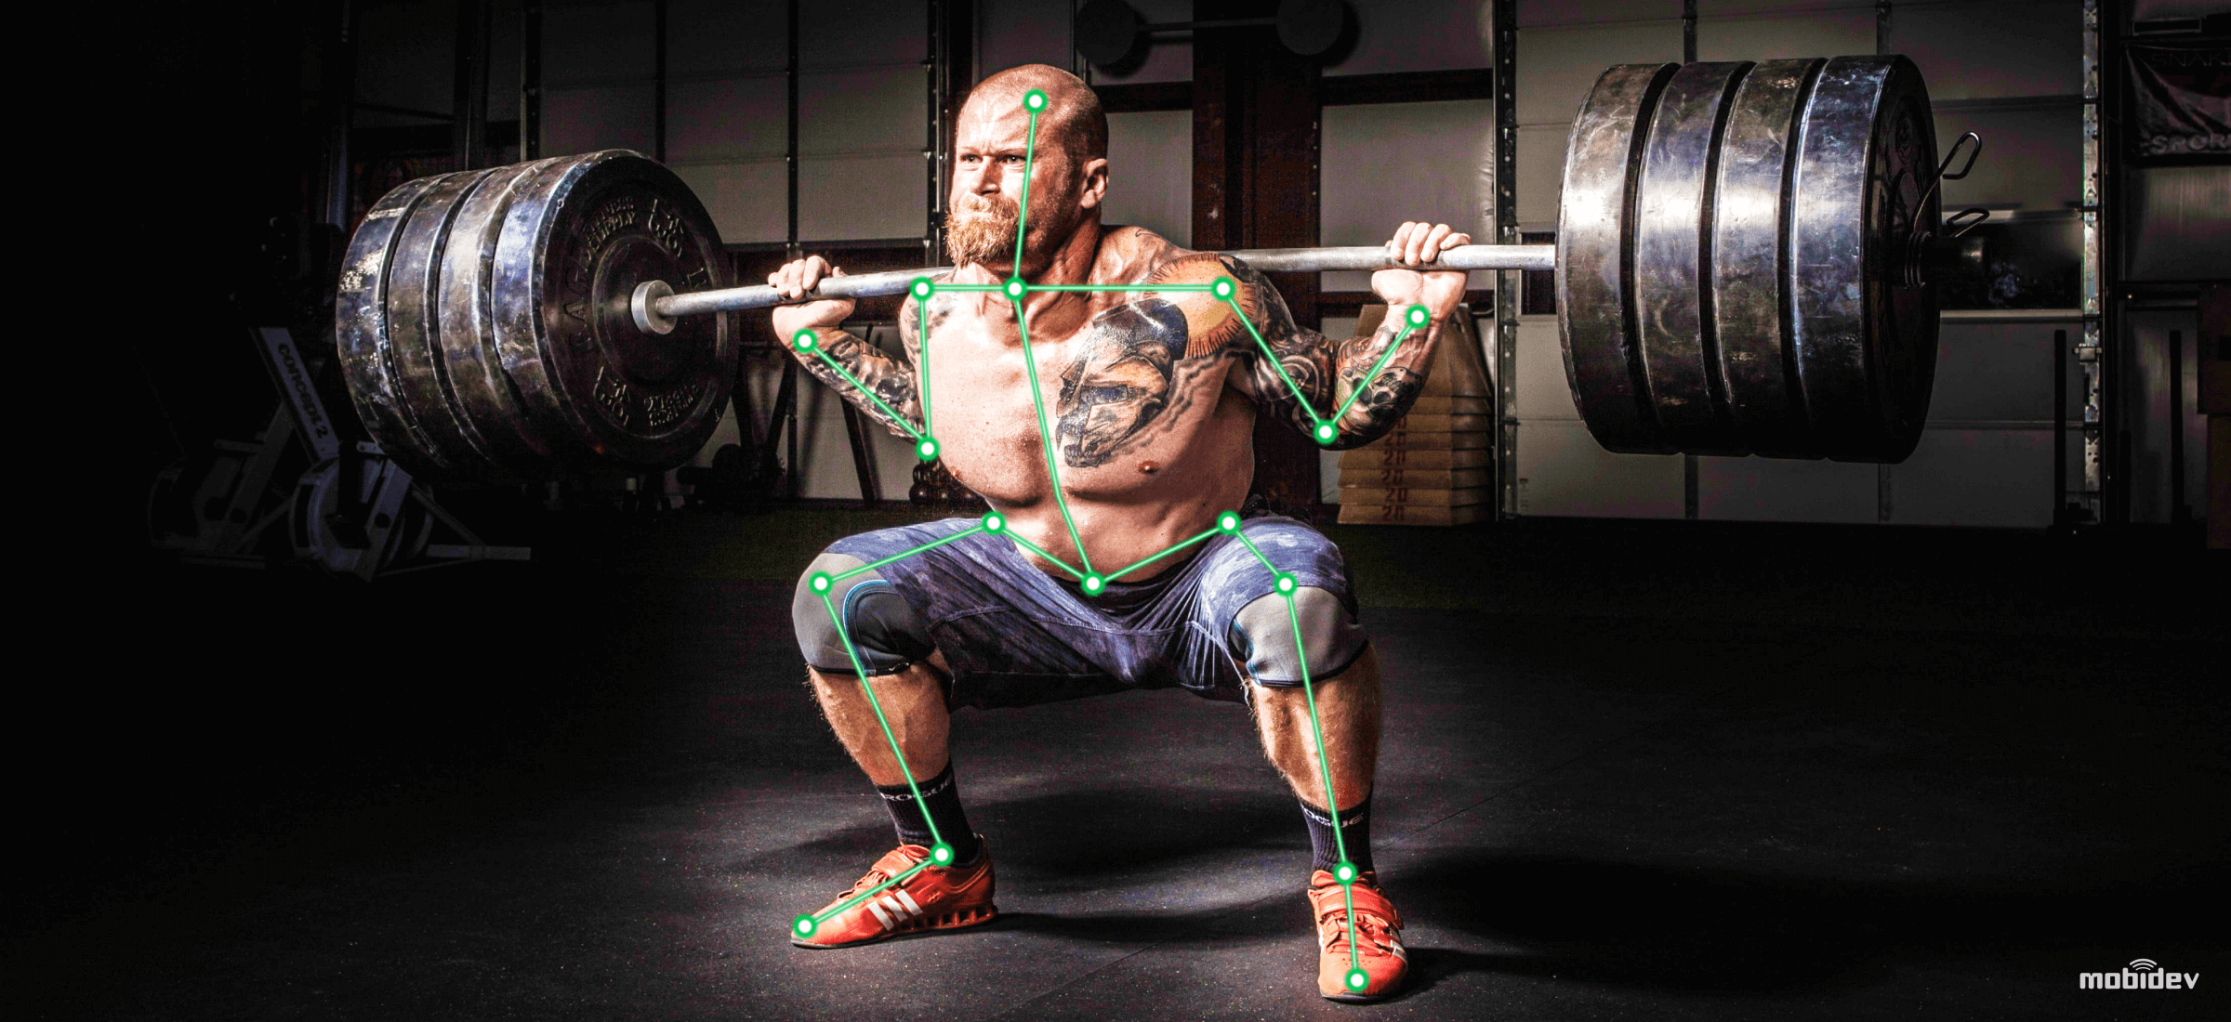
Large-Scale Body Movements

Slide 5
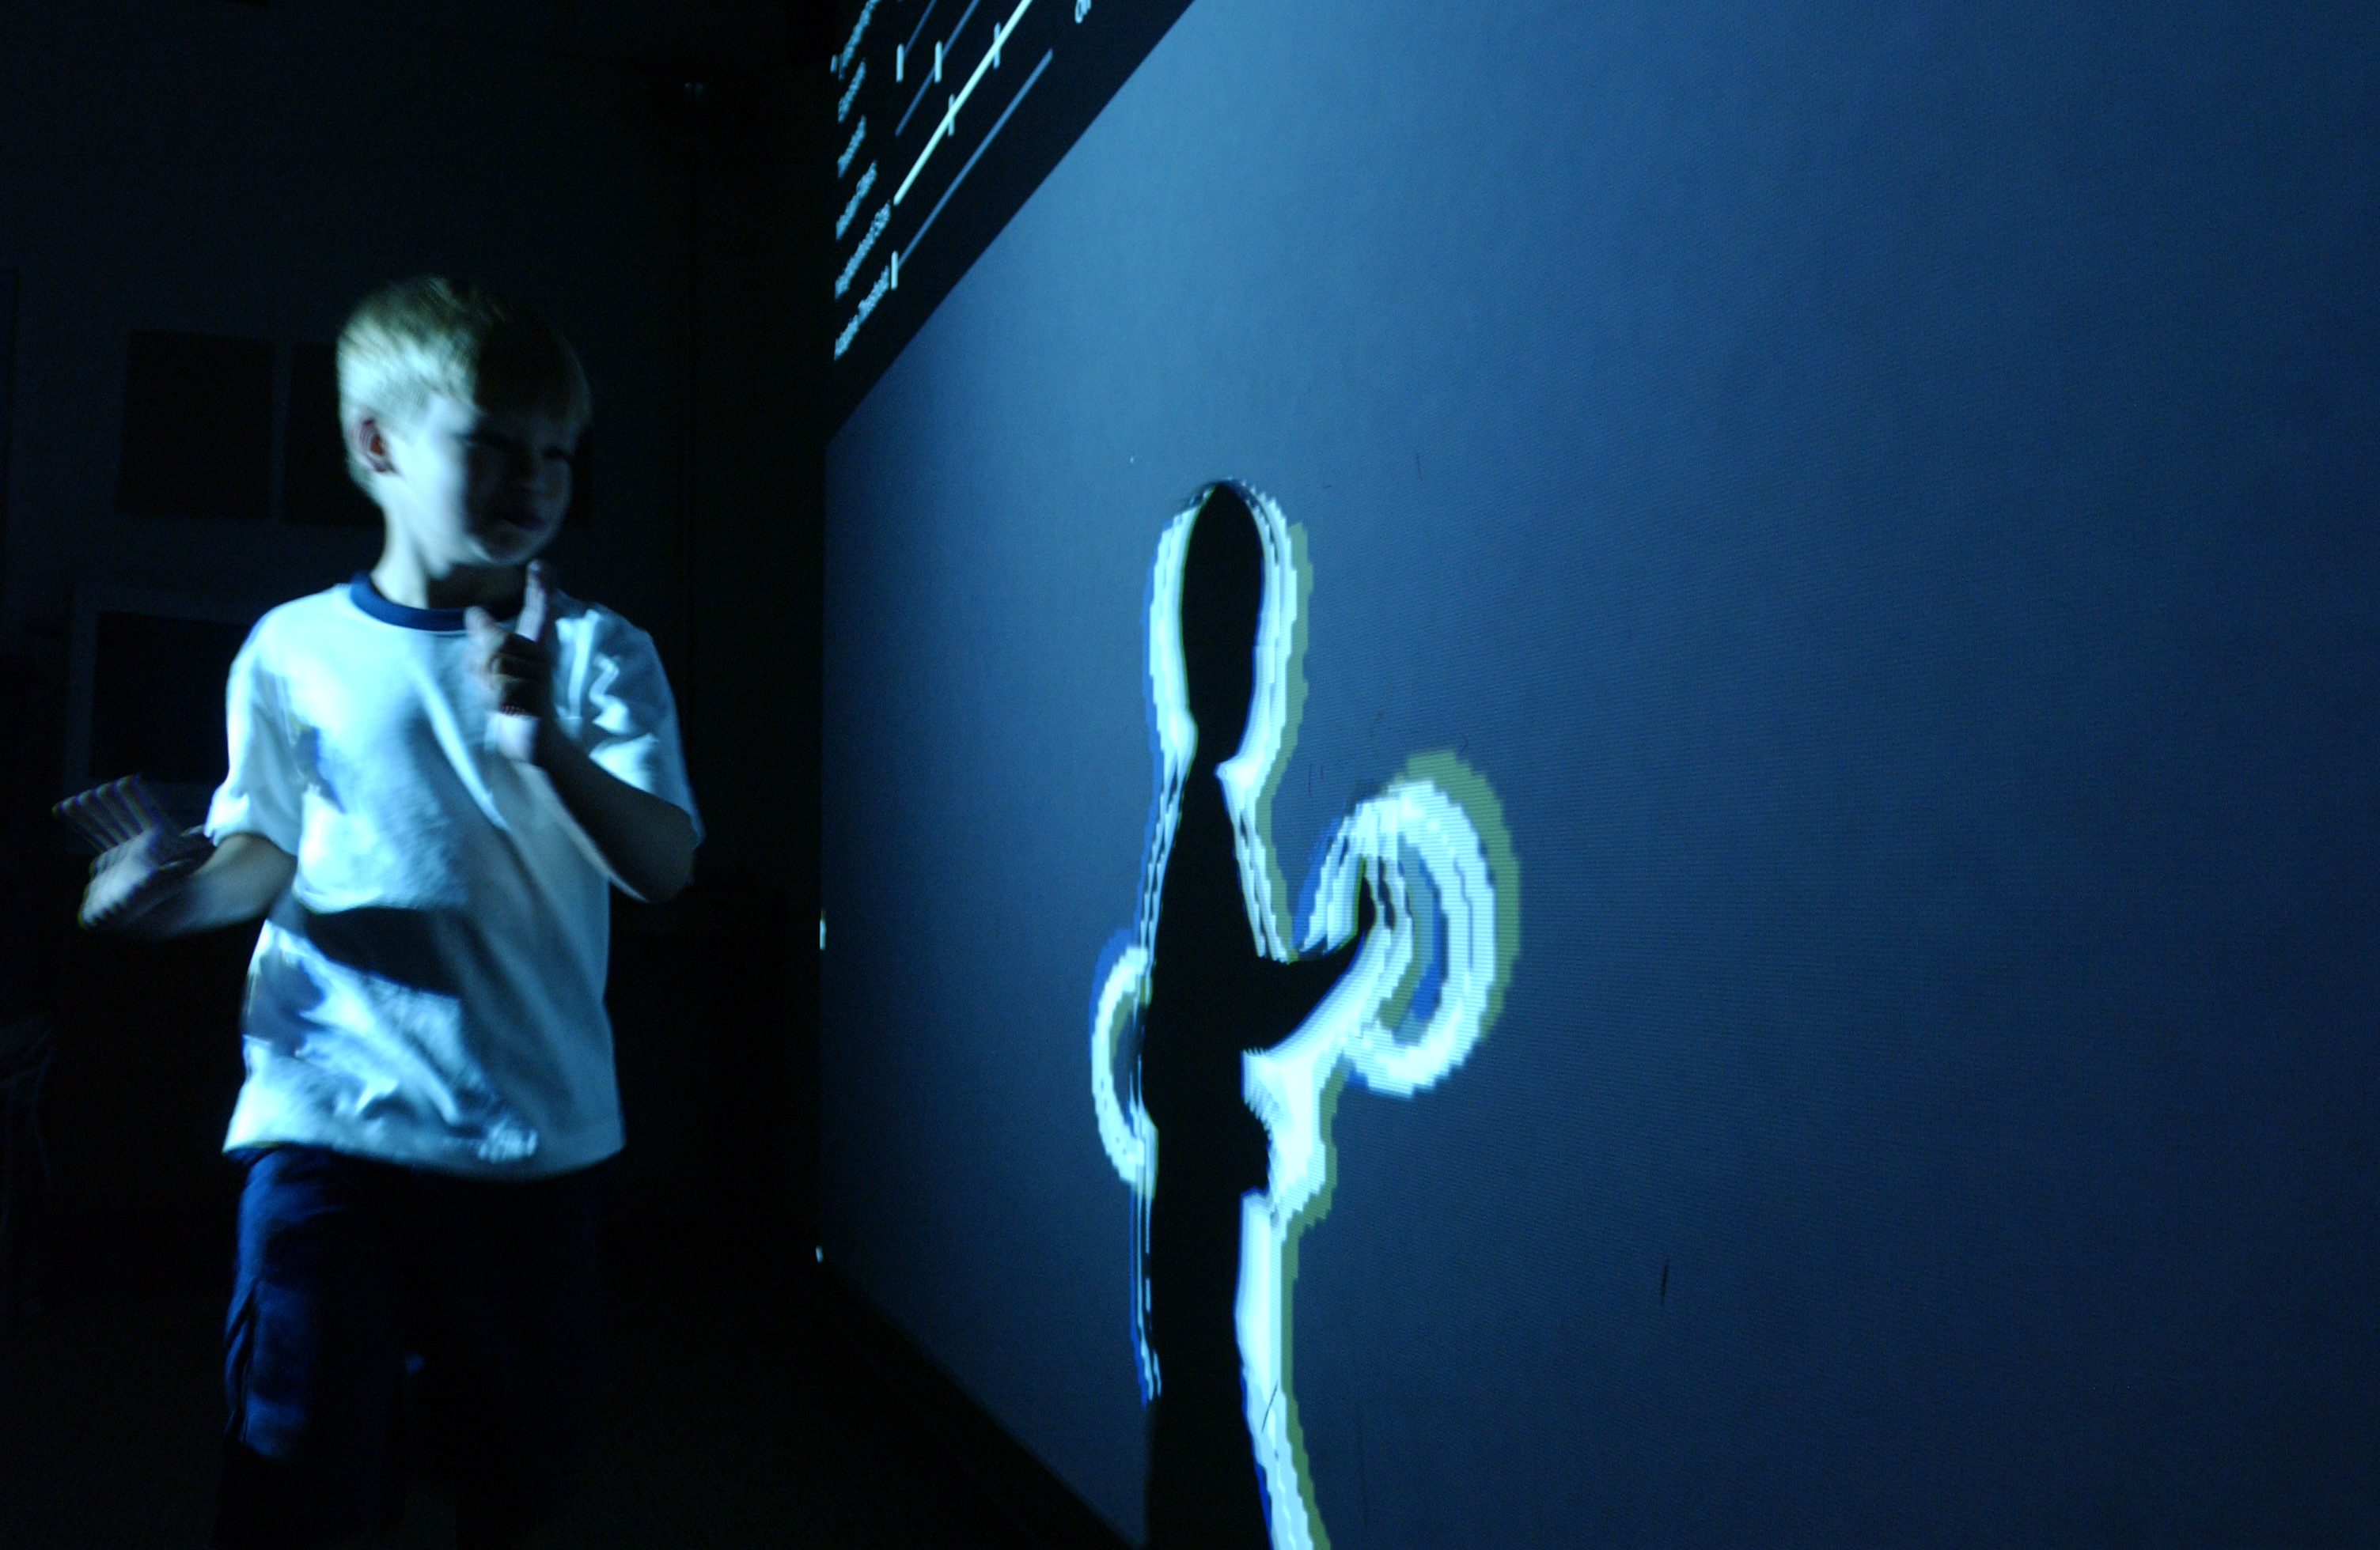
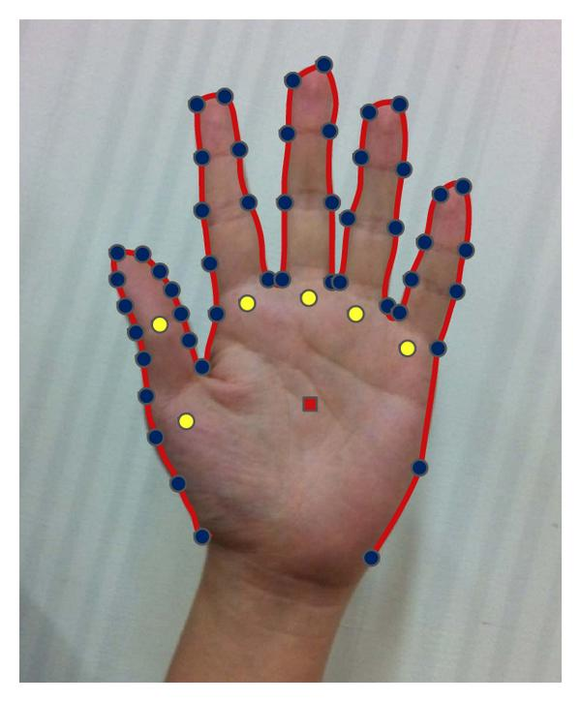
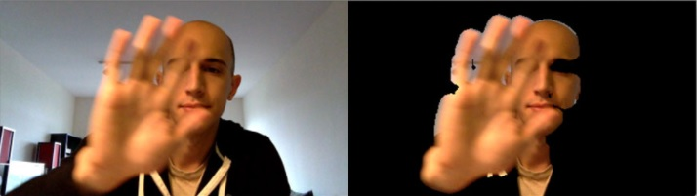
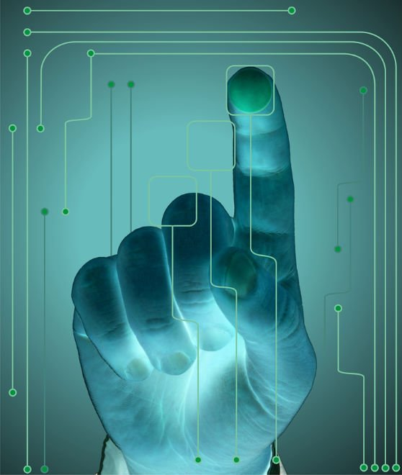

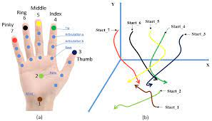
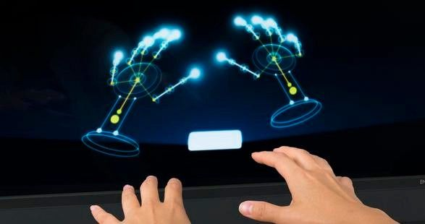
Gesture Recognition

Slide 6
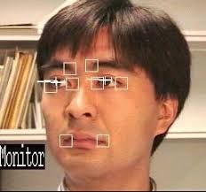

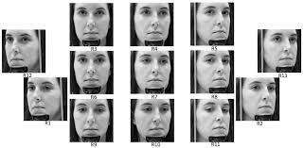
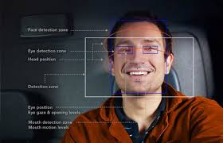
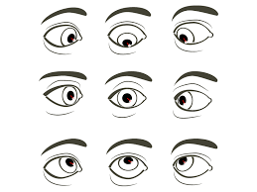
Facial Expression and Gaze Detection

Slide 7

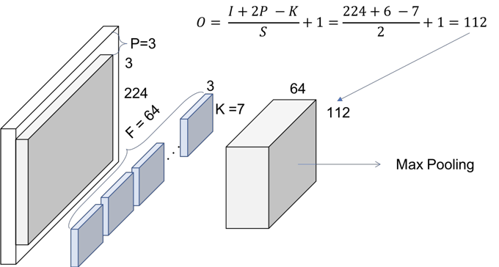
Convolution and Max Pooling

Slide 8
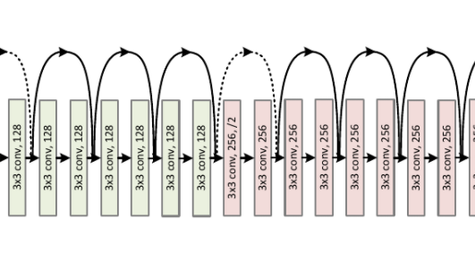
Attention States Classification
Deep Learning-Convolutional Neural Network
The Problem for typical architectures is Vanishing Gradients
With ResNets, the gradients can flow directly through the skip connections backwards from later layers to initial filters
ResNet34 is a good choice for Attention Extraction Systems

Slide 9
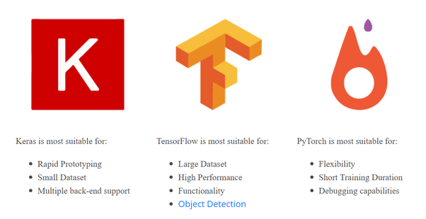
Programming Tools
Python
NumPy
Keras TensorFlow
Pytorch

Slide 10
Application
Drivers’ Attention Evaluation
Current Databases for attention are mostly one-modal
We need to create multi-modal images including all possible patterns of human attention-Eye Gaze, Facial Expression, Hand Gesture, and Body Posture

